Slide 1
Pizza Sales Analysis
"Welcome to our Pizza Sales Analysis Presentation! Today, we'll dive into the data behind our pizza orders to uncover valuable insights and trends."
Gmail: - nikeshs810@gmail.com
Nikesh singh

Slide 2
Problem of the statement
"Our pizza business is doing okay, but we're not sure why some pizzas sell
better than others, or Identify the top-selling pizza types to understand
customer preferences and tailor inventory accordingly. We need to look at
our sales data to figure out what customers really like and how we can
advertise better."

Slide 3
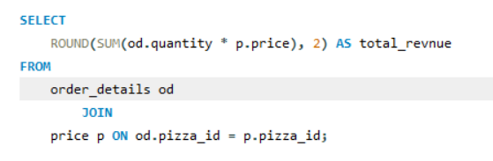
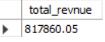
.
The Total Revenue Generated From Pizza Sales.

Slide 4
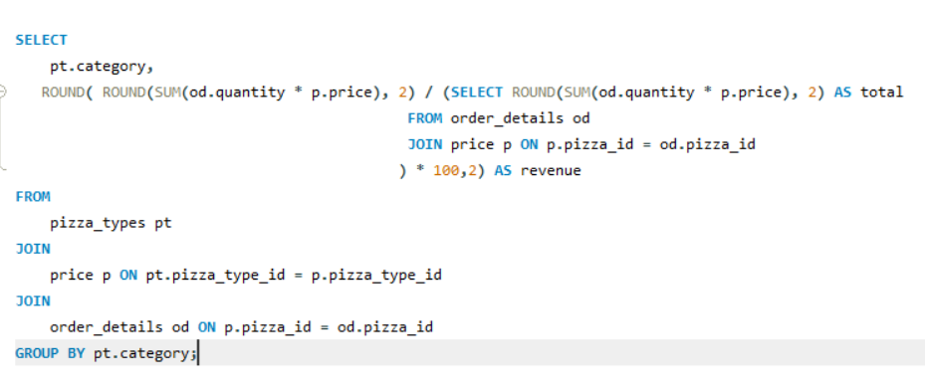
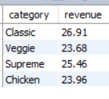
"The Percentage Contribution of Each
Pizza Type to Total Revenue"

Slide 5
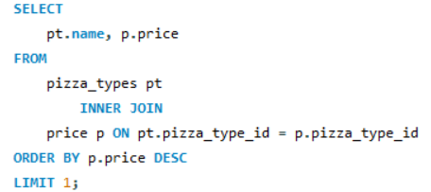

.
“The Most Expensive Pizza"

Slide 6
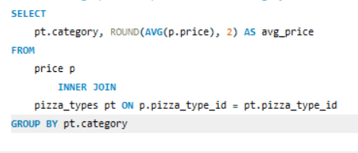
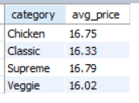
“ The Average Price Of Pizza In Each Category”

Slide 7
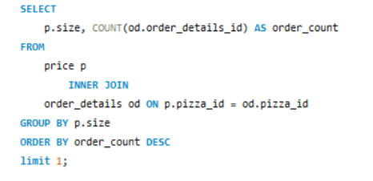
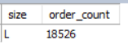
.
“The Most Popular Pizza
Size Ordered”

Slide 8
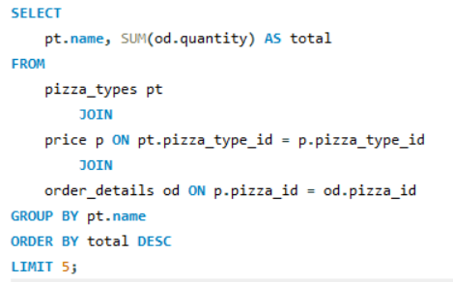
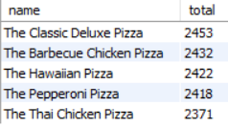
.
"Top 5 Pizza Types and Their
Quantities Ordered"

Slide 9
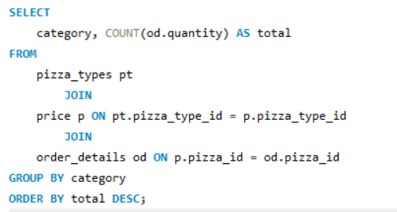
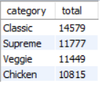
.
"The Total Quantity Ordered for Each Pizza Category"

Slide 10
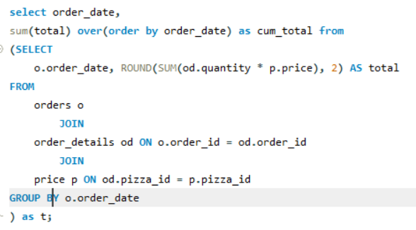
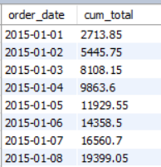
"Analyze the cumulative revenue
generated over time"

Slide 11
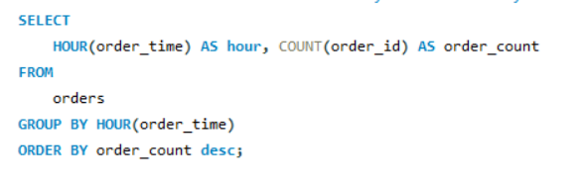
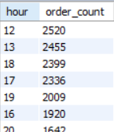
.
"The Distribution of Orders by Hour of the Day"

Slide 12
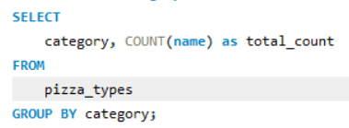
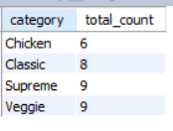
.
Category-Wise Distributio Of Pizzas

Slide 13
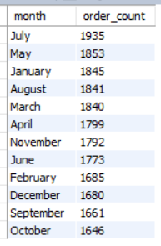
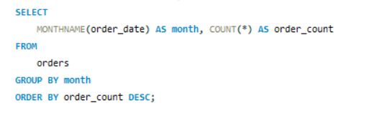
"The total number of orders placed in each month"

Slide 14
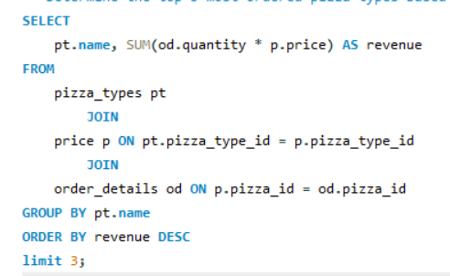
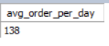
.
"Orders by Date and Average
Number of Pizza Orders per Day"

Slide 15
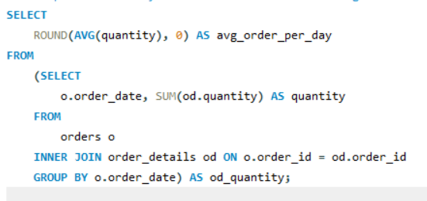
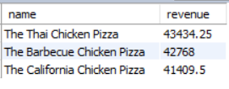
.
"Top 3 Pizza Types Based on Revenue"

Slide 16
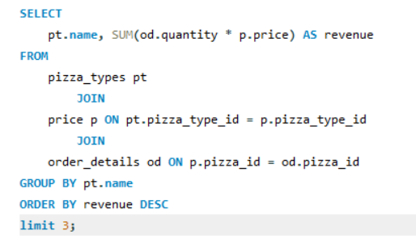
.
"Top 3 Pizza Types Based on Revenue"

Slide 17
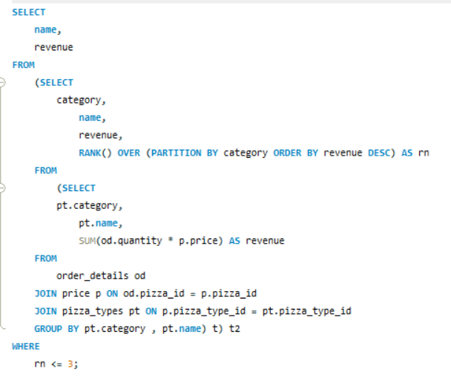
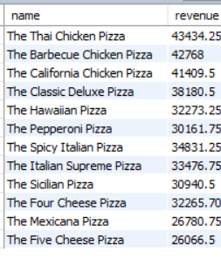
" Highest Revenue Generating Pizza
Types Across Categories"

Slide 18
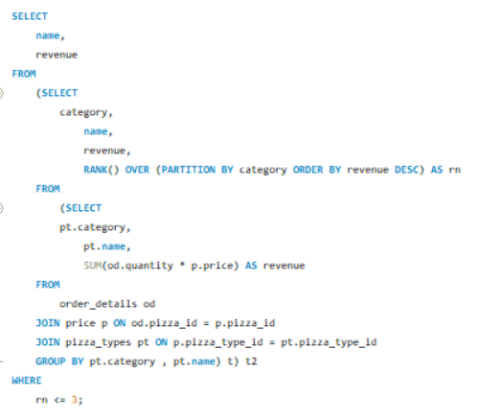
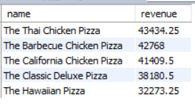
"Top 5 Highest Revenue Generating Pizza
Types Across Categories"

Slide 19
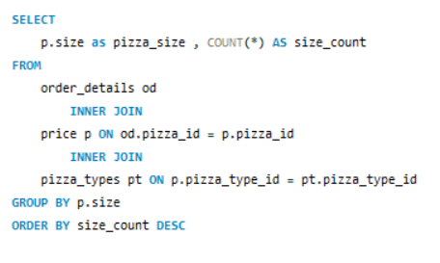
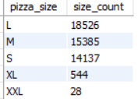
“ The most common pizza size ordered by customers”

Slide 20
INSIGHT FROM THE ANALYSIS
* our pizza sales have a total revenue of $817,860.05.
* The most expensive Pizza is “The Greek Pizza” with Price $35.96
*The average price of pizza in each category is between 16.02 to 16.75
*Large pizzas are the crowd favorite, with 18,526 orders, closely followed by 15,383 for medium pizzas,
and 14,137 for small pizzas.
* The pizza categories by total quantity ordered: Classic: 14,579 : Supreme: 11,777 : Veggie: 11,449
: Chicken: 10,815"
*Top Highest Revenue Generating Pizza Types Across Categories: Thai Chicken Pizza: $43,434.25
Barbecue Chicken Pizza: $42,768.00 : California Chicken Pizza: $41,409.50"
* In the months of July, May, and January, orders are at their peak, while in the months of October, November, and December, orders are lower.
* The Percentage Contribution of Each Pizza Type to Total Revenue : classic: 26.91%, Veggie: 23.68%
Supreme: 25.46% , Chicken: 23.96%"

Slide 21
THANK YOU

